Slide 1



WE WILL START AT 10:00 AM (CET)
SESEC V Webinar 21: China Energy Labelling 2025: Regulations and Standards as of 2025
You are muted
Use the Q&A or Chat Panel to submit your questions Keep your questions short and concise
Contact us: assistant@sesec.eu
Welcome to our website: https://sesec.eu/
Seconded European Standardization Expert in China (SESEC) Project
1

Slide 2

China Energy Labelling as of Oct 2025
Oct 21, 2025

Slide 3
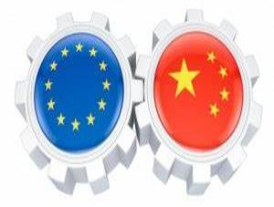


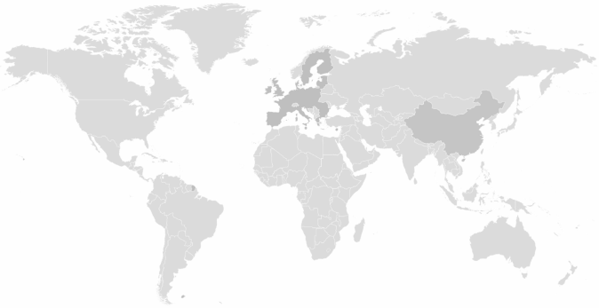





SESEC introduction
Partners and Role
SESEC Partners
European Commission (EC)-The executive body of the European Union; Responsible for proposing legislation, implementing decisions, upholding the treaties and day-to-day management of the EU; DG Grow is the main partner (80%)
European Free Trade Association (EFTA)-Iceland, Liechtenstein, Norway and Switzerland; Intergovernmental organization set up for the promotion of free trade and economic integration to the benefit of its four Member States; None EU members;
CEN-European Committee for Standardization
CENELEC-European Committee for Electrotechnical Standardization
ETSI-European Telecommunications Standards Institute
SESEC is a visibility project co-financed by five European partners

Slide 4

SESEC INTRODUCTION
A Project co-funded by EC, EFTA, CEN CENELEC & ETSI
Promote European and International standards in China
Improve contacts between Project Partners and different levels of the Chinese administration, industry and standardization bodies
Enhance visibility and understanding of the European Standardization System (ESS) in China.
Gather regulatory and standardization intelligence
Undertake technical lobbying
Goals
The SESEC initiative supports EC policy and ESOs strategic objectives in China.
Our ultimate goal is the enhancement of EU-China dialogue and cooperation
in the field of standardization.
It is notably expected to support the Framework Cooperation Agreement in place between the ESOs and SAC.
Promote European and International standards in China
Improve contacts between Project Partners and different levels of the Chinese administration, industry and standardization bodies
Enhance visibility and understanding of the European Standardization System (ESS) in China.
Gather regulatory and standardization intelligence
Undertake technical lobbying

Slide 5
Project’s Priorities
Priorities of SESEC
Horizontal：
China Standards 2035
Belt and Road Initiative
Standardization Reform
Institutional Changes in Chinese Government
Market Access (e.g CCC)
  Digital Transition
  IT in General
  Data
  Artificial Intelligence
  Quantum
  Industrial IoT
  5G/6G
  Green Transition:
  Energy Efficiency
  China RoHS
  Green Product Assessment
  Decarbonization
  New Energy （e.g.Hydrogen）
  Recycling

Slide 6
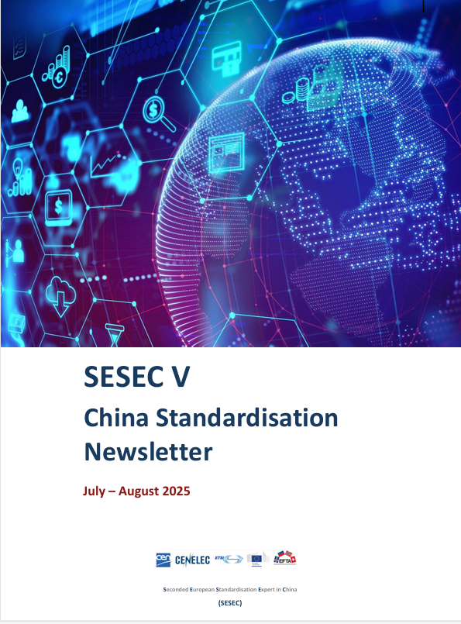
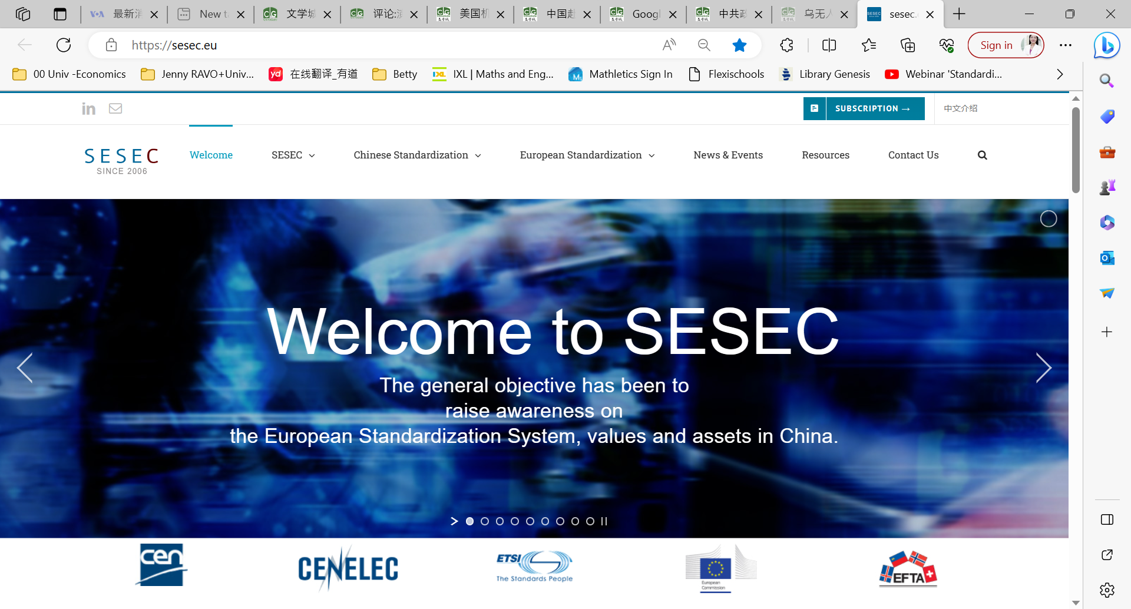
SESEC’s English Website
For European stakeholders
www.sesec.eu

Slide 7


China Energy Labelling 2025:
Regulations and Standards
21st Oct 2025

Slide 8


1. Overview: China’s Energy Label (CEL) System
Contents
Product Catalogue
2. The 2025 Regulatory Landscape
Implementation Rules
Applicable Standards
3. What’s New in 2025
4. The Compliance Roadmap
5. Conclusions

Slide 9
01
Overview: China’s Energy Label (CEL) System

Slide 10
1. Overview: China’s Energy Label (CEL) System
Energy Conservation Law
Product Quality Law
Regulation on the Implementation of the Law on the Inspection of Imported and Exported Commodities
Regulations on Certification and Accreditation
Superior Law
Measures for the Administration of Energy Efficiency Labels
Implementation Rules for CEL of Products in the Catalogue
Authorization Announcement
Implementation Notice
Supporting Documents
Product Catalogue
label format
…
Energy Efficiency Standard for Electric Motors
Energy Efficiency Standards
Energy Efficiency Standard for Household Refrigerators
Energy Efficiency Standard for Electric Washing Machines
…
Framework of CEL System
Notes:
中国能效标识框架源自《能效标识制度实施二十周年进展报告》：中国标准化研究院发布《能效标识制度实施二十周年进展报告》

Slide 11
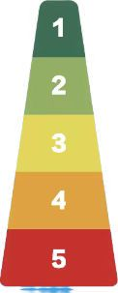
1. Overview: China’s Energy Label (CEL) System
Overview of the CEL System
Implementation Date
Competent Authorities
Authorized Institution
National Development and Reform Commission (NDRC)
State Administration for Market Regulation (SAMR)
China National Institute of Standardization (CNIS）
March 1, 2005
Product Scope
Nature of the System
17 batches of product catalogs have been released, with the latest update of 38 product categories as Sep 2025
Mandatory for the production, sale, and import of products within the catalogue
Supervision and Penalties
Label Type
Supervision: National and local inspections
Penalties: Rectification, sales bans, fines
Efficiency Grade: 1-3 or 1-5
• Level 1: Most efficient
• Level 3/5: Market access threshold
Testing
Technical Basis
By manufacturer (self-declaration) or certified 3rd-party bodies
Mandatory energy efficiency standards for end-use energy-consuming products
Label Usage
Testing Methods
Printed & affixed by manufacturer/importer with nationally unified specifications and styles
Implementation Pattern
Based on relevant national standards
Manufacturer self-declaration + label registration + market surveillance
Notes:
中国能效标识制度概况源自《能效标识制度实施二十周年进展报告》：中国标准化研究院发布《能效标识制度实施二十周年进展报告》
其中原文（截止2025年4月）的产品范围涵盖45类产品，而最新产品目录（截止2025年10月）涵盖38类产品；已更新~

Slide 12



1. Overview: Label Registration - Products and Testing Labs
As of the end of 2024
According to official data, there were over 26,000 registered manufacturers and more than 4 million registered product models.
26,000+ registered manufacturers
4 million+ registered product models
Since 2009, the laboratory registration system has been implemented, with over 2,000 institutions participating in energy efficiency label testing, effectively supporting the implementation of the energy efficiency labeling system.
2,000+ participating testing institutions
Notes:
中国能效标识制度概况源自《能效标识制度实施二十周年进展报告》：中国标准化研究院发布《能效标识制度实施二十周年进展报告》

Slide 13
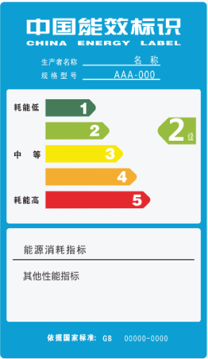
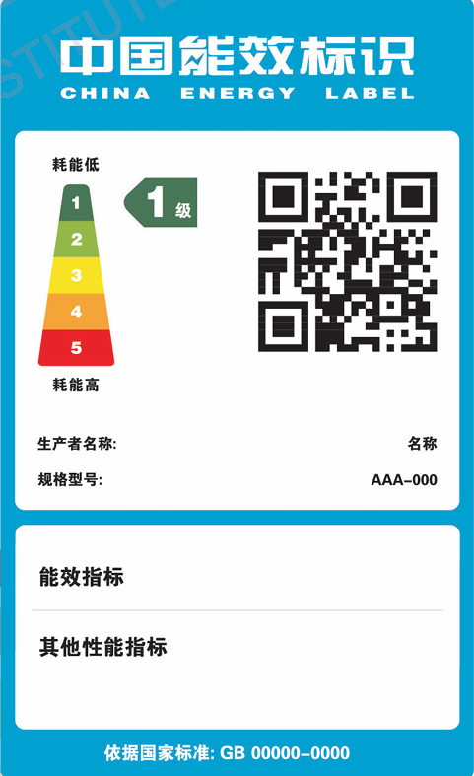
1. Overview: Evolution of CEL Appearance
Key Information on the Energy Label
Core Efficiency Metrics | Energy Efficiency Grade (1-3): Clear visual ranking, Grade 1 represents the highest efficiency.
 | Energy Consumption/Key Indicator: e.g., kWh/cycle, thermal efficiency (%).
Product & Producer Identification | Producer Name (or brand)
 | Product Model Number
Compliance & Verification | Mandatory Standard Number: References the official GB standard used for testing.
 | QR Code: Provides instant access to the official public record for verification.
The first edition of CEL
Currently applied format since 206
Notes:
中国能效标识制度概况源自《能效标识制度实施二十周年进展报告》：中国标准化研究院发布《能效标识制度实施二十周年进展报告》

Slide 14
1. Overview: CEL System & EU EED
China-EU Energy Efficiency Policy Comparison
Dimension | China Energy Label System (2025 Update) | EU EED & EE1st Principle
Core Concept | Guides the market and consumers through product energy efficiency grading | Establishes energy efficiency as a fundamental principle of energy policy, systematically prioritizing demand-side resources
Target Setting | Supports national carbon deduction goals by improving the efficiency of specific products | A binding target to reduce final energy consumption by 11.7% by 2030 compared to 2020 projections
Key Measures | Publishes the "Product Catalog (2025 Edition)" and implementation rules, covering appliances, motors, etc. | Implements a renewables-based and integrated Energy System, sets annual renovation obligations for the public sector (1.9%), and promotes Energy Performance Contracting (EPC)
Binding Nature | Mandatory: Products must be labeled and meet minimum standards | Mandatory: The 2030 final energy consumption target is collectively binding on Member States
Implementation Level | Focuses on end-use energy-consuming products | Integrated throughout the entire decision-making process (strategy, planning, investment)
Synergy & Differences | Aligned Path: Both recognize energy efficiency as key to the energy transition. Complementary Scope: China's system targets the manufacturing side of products, while the EU directive covers system operation.
Notes:
将中国能效标识制度与欧盟EED进行了对比
信息来源于The-new-2023-EED-Guidance-for-national-planning-and-implementation
及网络：https://finance.sina.cn/app/article/bdmini.d.html?docID=mznarkp0135663

Slide 15
02
The 2025 Regulatory Landscape

Slide 16
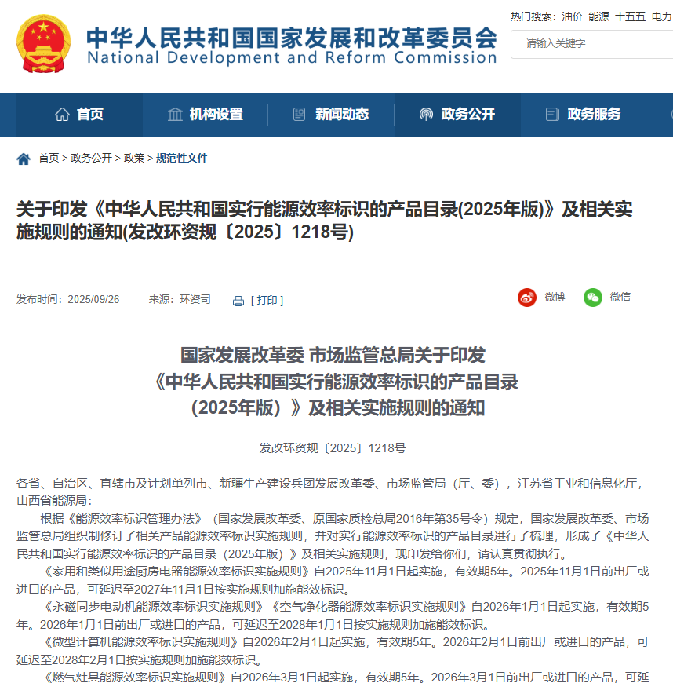

2. The 2025 Regulatory Landscape-Newly Issued Announcement
On Sept 26, 2025, NDRC and SAMR jointly released announcement on China Energy Label Product Catalogue (2025 Edition) (Document No. FGHRZR [2025] No. 1218)
With this update, China's energy efficiency labeling management now covers 38 product categories, thereby bringing the implementation rules into accordance with current national standards.
Notes:
领域分类逻辑参照《能效标识二十周年报告》

Slide 17



2. The 2025 Regulatory Landscape-Product Catalogue
As of Oct 2025, CEL Product Catalogue covers 38 product categories in 5 areas.
Household Appliances (10)
Refrigeration and Air Conditioning (8)
Industrial Equipment (9)
Electric Washing Machines
Storage-type Electric Water Heaters
Household and Similar Kitchen Appliances (household induction cookers, electric rice cooker, microwave oven)
Household Gas Instantaneous Water Heaters and Gas Heating Water Boilers
Household Solar Water Heating Systems
Electric Fans
Range Hoods
Gas Stoves
Household and Similar AC Ventilation Fans
Air Purifiers
Household Refrigerators
Unitary Air Conditioners
Heat Pumps and Water Chillers
Room Air Conditioners
Multi-connected (VRF) Air Conditioning (Heat Pump) Units
Heat Pump Water Heaters
Ducted Air Conditioning Units
Commercial Refrigerating Appliances (Refrigerated beverage vending machines, remote commercial refrigerated cabinets, self-contained commercial refrigerated cabinets)
Small and Medium Three-phase Asynchronous Motors
AC Contactors
Displacement Air Compressors
Power Transformers
Ventilation Fans
Welding Machines
Commercial Induction Cookers
Permanent Magnet Synchronous Motors
Cage Three-Phase High Voltage Induction Motor
Notes:
领域分类逻辑参照《能效标识二十周年报告》

Slide 18


2. The 2025 Regulatory Landscape-Product Catalogue
As of Oct 2025, CEL Product Catalogue covers 38 product categories in 5 areas.
Electronic Information (6)
Lighting Equipment (5)
Monitors
Copiers, Printers, and Fax Machines
Flat Panel Televisions and Set-Top Boxes
Microcomputers
Projectors
Tower and Rack Servers
Self-ballasted Fluorescent Lamps for General Lighting Service
High-Pressure Sodium Lamps
LED Products for Indoor Lighting
LED Luminaires for Road and Tunnel Lighting
LED Panel Lights for General Lighting
Notes:
领域分类逻辑参照《能效标识二十周年报告》

Slide 19
2. The 2025 Regulatory Landscape-Implementation Rules
As of October 2025, the energy efficiency labelling system is governed by a comprehensive set of implementation rules.
CEL 001-2016 Implementation Rules for Energy Efficiency Labelling of Household Refrigerators
CEL 003-2016 Implementation Rules for Energy Efficiency Labelling of Electric Washing Machines
CEL 004—2016 Implementation Rules for Energy Efficiency Labelling of Unitary Air Conditioners
CEL 005—2025 Implementation Rules for Energy Efficiency Labelling of Self-ballasted Fluorescent Lamps for General Lighting Service
…
34 Currently Active Rules
42 implementation rules
(1 of 38 has 4 implementation rules)
Implementation Rules for Energy Efficiency Labelling of Household and Similar Kitchen Appliances
Implementation Rules for Energy Efficiency Labelling of Microcomputers
Implementation Rules for Energy Efficiency Labelling of Gas Stoves
Implementation Rules for Energy Efficiency Labelling of Permanent Magnet Synchronous Motors
Implementation Rules for Energy Efficiency Labelling of Air Purifiers
Implementation Rules for Energy Efficiency Labelling of Cage Three-Phase High Voltage Induction Motor
Implementation Rules for Energy Efficiency Labelling of Commercial Refrigerating Appliances
CEL 046-2025 Implementation Rules for Energy Efficiency Labelling of Tower and Rack Servers
8 New Rules Pending Enforcement
Notes:
数据来源于2025年能效标识产品目录【关于印发《中华人民共和国实行能源效率标识的产品目录(2025年版)》及相关实施规则的通知(发改环资规〔2025〕1218号)】-国家发展和改革委员会

Slide 20
2. The 2025 Regulatory Landscape-Implementation Rules
New Rules Pending Enforcement | Implementation Effective Date | Validity Period | Transition Period
Implementation Rules for Energy Efficiency Labelling of Household and Similar Kitchen Appliances | Nov. 1, 2025 | 5 years | Nov. 1, 2025-Nov. 1, 2027
Implementation Rules for Energy Efficiency Labelling of Microcomputers | Feb. 1, 2026 |  | Feb. 1, 2026-Feb. 1, 2028
Implementation Rules for Energy Efficiency Labelling of Gas Stoves | Mar. 1, 2026 |  | Mar. 1, 2026-Mar. 1, 2028
Implementation Rules for Energy Efficiency Labelling of Permanent Magnet Synchronous Motors | Jan. 1, 2026 |  | Jan. 1, 2026-Jan. 1, 2028
Implementation Rules for Energy Efficiency Labelling of Air Purifiers | Jan. 1, 2026 |  | Jan. 1, 2026-Jan. 1, 2028
Implementation Rules for Energy Efficiency Labelling of Cage Three-Phase High Voltage Induction Motor | Apr. 1, 2026 |  | Apr. 1, 2026-Apr. 1, 2028
Implementation Rules for Energy Efficiency Labelling of Commercial Refrigerating Appliances | Apr. 1, 2026 |  | Apr. 1, 2026-Apr. 1, 2028
CEL 046-2025 Implementation Rules for Energy Efficiency Labelling of Tower and Rack Servers | Dec. 1, 2025 |  | Dec. 1, 2025-Dec. 1, 2027
Among the 8 implementation rules, 2 will enter into force in later 2025 and 6 will be effective in 2026, all of which are equipped with 2-year transition period
Notes:
数据来源于2025年能效标识产品目录【关于印发《中华人民共和国实行能源效率标识的产品目录(2025年版)》及相关实施规则的通知(发改环资规〔2025〕1218号)】-国家发展和改革委员会

Slide 21
2. The 2025 Regulatory Landscape-Standards
As of October 2025, 38 Mandatory energy efficiency standards govern the product categories,
with 35 currently effective and 3 set to take effect in 2026.
Currently Effective Standards (35)
GB 12021.2-2015 The maximum allowable values of the energy consumption and energy efficiency grade for household refrigerators
GB 12021.4-2013 The maximum allowable values of the energy，water consumption and grades for household electric washing machines
GB 19576-2019 Minimum allowable values of energy efficiency and energy efficiency grades for unitary air conditioners
GB 19044-2022 Minimum allowable values of energy efficiency and energy efficiency grades of fluorescent lamps for general lighting
GB 19573-2004 Limited values of energy efficiency and rating criteria for high-pressure sodium vapour lamps
GB 18613-2020 Minimum allowable values of energy efficiency and values of efficiency grades for motors
…
Standards to be Effective (3) | Effective Date
GB 28380-2025 Minimum allowable values of energy efficiency and energy grades for microcomputers | Feb. 1, 2026
GB 30720-2025 Minimum allowable values of energy efficiency and energy efficiency grades for gas cooking appliances | Mar. 1, 2026
GB 26920-2024 Minimum allowable values of energy efficiency and energy efficiency grades for commercial refrigerating appliances | Apr.1, 2026
Notes:
数据来源于2025年能效标识产品目录【关于印发《中华人民共和国实行能源效率标识的产品目录(2025年版)》及相关实施规则的通知(发改环资规〔2025〕1218号)】-国家发展和改革委员会

Slide 22
03
What’s New in 2025

Slide 23
3. What’s New in 2025
1. Scope Expansion: New Kitchen Category
Household Kitchen Appliances added as a new independent category
Covers rice cookers, microwaves, induction cookers
Energy management extends to daily-use kitchen ecosystem

Slide 24
3. What’s New in 2025
2. Updated Implementation Rules Effective in 2025
CEL 005—2025 Implementation Rules for Energy Efficiency Labelling of Self-ballasted Fluorescent Lamps for General Lighting Service
CEL 008-2025 Implementation Rules for Energy Efficiency Labelling of Water Chilling (Heat Pump) Packages
CEL 032-2025 Implementation Rules for Energy Efficiency Labelling of Water-Source（Ground-Source）Heat Pumps
CEL 033-2025 Implementation Rules for Energy Efficiency Labelling of Lithium Bromide Absorption Water Chiller (Heater)
CEL 042-2025 Implementation Rules for Energy Efficiency Labelling of Low Ambient Temperature Air Source Heat Pump （Water Chilling）Packages
Implementation Rules for Energy Efficiency Labelling of Household and Similar Kitchen Appliances
CEL 019-2025 Implementation Rules for Energy Efficiency Labelling of Displacement Air Compressors
CEL 020-2025 Implementation Rules for Energy Efficiency Labelling of Power Transformers
CEL 036-2025 Implementation Rules for Energy Efficiency Labelling of Household and Similar AC Ventilation Fans
CEL 046-2025 Implementation Rules for Energy Efficiency Labelling of Tower and Rack Servers
Effective on Feb. 1, 2025 with a 2-year transition period
Four rules for Heat Pumps and Water Chillers; Effective on Feb. 1, 2025 with a 2-year transition period
Through the systematic formulation, revision, and replacement of a large number of implementation rules, the regulatory framework is ensured to be clear, unified, and up-to-date.
Will be Effective on Nov. 1, 2025 with a 2-year transition period
Effective on Feb. 1, 2025
Effective on Feb. 1, 2025 with a 2-year transition period
Effective on Feb. 1, 2025
Will be Effective on Dec. 1, 2025 with a 2-year transition period

Slide 25
3. What’s New in 2025
3. Standard Upgrades: Higher Efficiency Bar
Effective Standards in 2025
GB 19577-2024 Minimum allowable values of the energy efficiency and energy efficiency grades for heat pumps and water chillers
GB 21456-2024 Minimum allowable values of the energy efficiency and energy efficiency grades for household and similar kitchen appliances
GB 20052-2024 Minimum allowable values of energy efficiency and the energy efficiency grades for power transformers
GB 30253-2024 Minimum allowable values of energy efficiency and energy efficiency grades for permanent magnet synchronous motors
GB 36893-2024 Minimum allowable values of energy efficiency and energy efficiency grades for air cleaner
GB 43630-2023 Minimum allowable values of energy efficiency and energy efficiency grades for tower and rack servers
GB 30254-2024 Minimum allowable values of energy efficiency and energy efficiency grades for cage three-phase high voltage induction motor
Updated standards keep driving industrial technological advancement

Slide 26
04
The Compliance Roadmap

Slide 27
4. The Compliance Roadmap-Core Principle
Governance Model
Manufacturers self-declare + Label registration + Market surveillance
The manufacturer is the primary responsible party for the accuracy of energy efficiency information.
Legal Basis
China Energy Labeling Product Catalogue (2025 Edition)
Product-specific Implementation Rules for Energy Efficiency Labelling
Official Platform
China Energy Label Website (www.energylabel.gov.cn)
All Label registration procedures are completed on this portal.

Slide 28
4. The Compliance Roadmap-Label Registration Process
1. Product Testing
3. Online Filing
5. Confirmation
2. Enterprise Registration
4. Label Production
Notes:
备案流程参照网络：https://mp.weixin.qq.com/s/jO12m-JAutgXXAJn884WWA

Slide 29
4. The Compliance Roadmap-Key Operational Details
Enterprise Registration
Access Portal: Navigate to the official Energy Label Filing System website （https://www.energylabel.com.cn/indexEnergy）.
Register Account: Complete the company registration with all required details.
Log In: Use your credentials to access the filing system.
Product Testing Phase
Confirm Inclusion: Verify the product is listed in the China Energy Label Product Catalog (2025 Edition)
Conduct Testing: Testing must be performed in CNIS-approved laboratories, including both in-house and third-party facilities.
Obtain Report: Receive the official “Test Report.”
Online Filing
Select Product: Choose the specific product model for filing within the system.
Complete Forms: Fill in the online product filing application form.
Upload Documents: Submit the electronic copy of the "Test Report."
Key Operational Details
Notes:
备案流程参照网络：https://mp.weixin.qq.com/s/jO12m-JAutgXXAJn884WWA

Slide 30
4. The Compliance Roadmap-Key Operational Details
Label Production
Download Template: Go to the "Download Zone" on the official website and download the correct label template for your product.
Self-Produce: Manufacturers are responsible for printing and affixing the labels according to the template specifications.
Confirmation
Public Query: Return to the official website and access the "Filing Announcement Query" section.
Search Product: Search for your product by type and name.
Verify Success: If your product's filing information is displayed, the process is complete and successful.
Key Operational Details
Notes:
备案流程参照网络：https://mp.weixin.qq.com/s/jO12m-JAutgXXAJn884WWA

Slide 31
4. The Compliance Roadmap-Label Application
Print In-House
Accuracy: Ensure all data (e.g., model, efficiency grade) exactly matches your filed record.
Compliance: Adhere strictly to the official specs for size, color, and layout.
Material: Use 80gsm or heavier art paper.
Apply Correctly
Placement: Affix to a prominent location on the product itself or its minimal packaging.
Durability: Ensure it is firmly attached and remains legible.
Notes:
资料来源于《能效标识管理办法》：https://www.gov.cn/zhengce/2021-11/30/content_5713245.htm

Slide 32
4. The Compliance Roadmap-Critical Reminders & Risk Avoidance
Q1: What if we upgrade the product or need to change information?
A: Changes affecting energy efficiency metrics require re-testing and updating the Label registration. For non-core info (e.g., contact details), modify directly in the system.
Q2: Our product already has a top EU energy class (e.g., A). Is that sufficient for the China market?
A: No. This is a critical misconception. The testing standards and calculation methodologies between the EU and China are fundamentally different.
Q3: We have registered our product in the EU's EPREL database. Do we need to do another registration for China?
A: Yes, absolutely. The Chinese Energy Label filing system is a completely separate and independent system from the EU's EPREL.
Notes:
合规建议来源于deepseek总结

Slide 33
4. The Compliance Roadmap-Critical Reminders & Risk Avoidance
Q4: Who is legally responsible for registering the product in China?
A: The registration must be submitted by a legal entity physically located in China.
This can be your:
Local subsidiary
Official importer
Authorized representative
The parent company in Europe cannot directly register the product in the Chinese system. Ensuring you have a compliant local entity is a mandatory step for market access.
Q5: How to avoid risks from market supervision?
A: No Misrepresentation: Ensure data consistency across the Test Report, Label registration Filing, and Physical Product.
Timely Updates: Update Label registration info promptly when standards or rules change.
Keep Records: Safely store the test report, Label registration confirmation, and all related documents.
Notes:
合规建议来源于deepseek总结

Slide 34
4. The Compliance Roadmap-Summary
Confirm First: Check the Directory to confirm product category and applicable rules.
Execute Precisely: Test with a compliant lab, ensure authentic data, produce labels correctly.
Remain Accountable: Complete the Label registration, accept market supervision, and adapt to changes proactively.

Slide 35
05
Conclusion

Slide 36
5. Conclusion-Beyond Compliance - Creating Value
Meeting Regulatory Requirements: Successfully completing the filing process is a fundamental obligation for the legal sale of products.
Enhancing Brand Image: It demonstrates a company's commitment to energy conservation and environmental protection, strengthening consumer trust and brand reputation.
Promoting Market Fairness: A unified energy efficiency label provides consumers with clear decision-making information, maintaining a fair competitive market environment.
Driving Green Innovation: It incentivizes manufacturers to continuously improve product energy efficiency, contributing to global sustainable development.

Slide 37
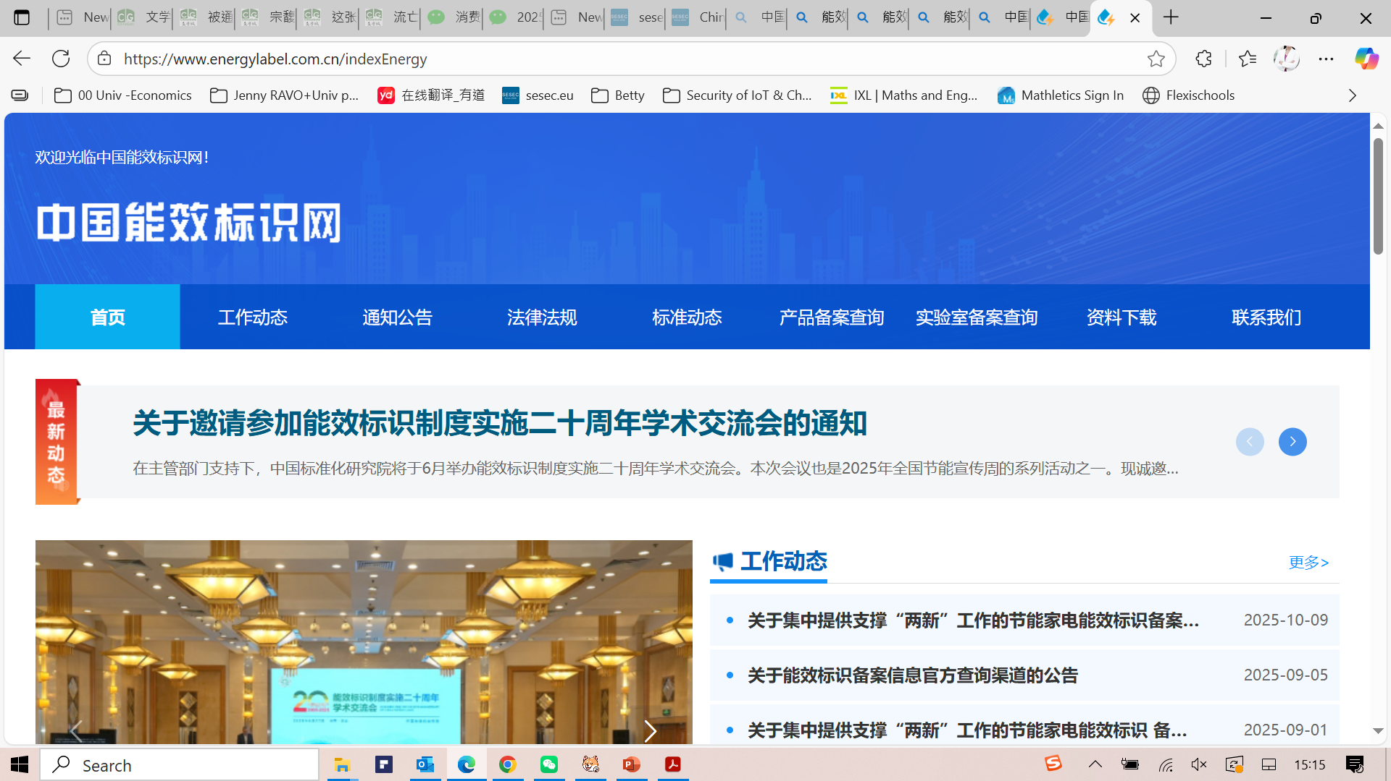
China Energy Efficiency Lable Website - 中国能效标识网

Slide 38
Thank You

