Slide 1




WE WILL START AT 10:00 AM (CET)
SESEC V Webinar
Chinese Standardization System
and FIE Engagement
ü
ü ü ü ü
ü ü
You are muted
Use the Q&A or Chat Panel to submit your questions Keep your questions short and concise
Your questions will be answered after the presentation Slides and recording will be sent to you afterwards
Contact us: assistant@sesec.eu
Welcome to our website: https://sesec.eu/
Seconded European Standardization Expert in China (SESEC) Project
1

Slide 2


SESEC INTRODUCTION
A Project co-funded by EC, EFTA, CEN CENELEC & ETSI
v
v
v
v v
Promote European and International
standards in China
Improve contacts between Project Partners and different levels of the Chinese administration, industry and standardization bodies
Enhance visibility and understanding of the European Standardization System (ESS) in China.
Gather regulatory and standardization intelligence
Undertake technical lobbying
Goals
• The SESEC initiative supports EC policy and ESOs strategic objectives in China.
• Our ultimate goal is the enhancement of EU-China dialogue and cooperation in the field of standardization.
• It is notably expected to support the Framework Cooperation Agreement in place between the ESOs and SAC.
2
Dr. Betty XU |
[April 18, 2023 ]

Slide 3
SESEC V LAUNCHED IN OCT 2022
Goals and Tasks
Call for stakeholders’ Strategic Comments on Standardization Cooperation with China
Please contact
SESEC team via assistant@sesec.eu
Ms. Zhuohua Chen zchen@cencenelec.eu in CEN/CENELEC Management Centre, Ms. Margot Dor margot.dor@etsi.org in ETSI,
Ms. VACCARO Silvia Silvia.VACCARO@ec.europa.eu in European Commission, and Ms. Gudrun Rögnvaldardóttir, gur@efta.int in EFTA, for more details of SESEC project.
3
Dr. Betty XU | [APRIL 18, 2023 ]

Slide 4

Chinese Standardization System and FIE Engagement
Betty Xu, Director of the SESEC project

Slide 5

Content
Standardization system in China
Identify standards applicable to your products
Which standards must be followed
International standards in China
Get involved in standardization work

Slide 6



2. Standardization System in China
—Legal framework
LAW
The Standardization Law of China
  Provide framework for China‘s standardization work
  Define basic elements of standardization work
  SAC – standardisation authority
Administrative measures for mandatory national standards (2020)
Administrative measures for national standards (2022)
Administrative measures for local standards (2020)
Administrative measures for association standards (2019)
Administrative measures for enterprise standardization (2016)
  …
REGULATIONS
    Administrative authority in different sectors
  MIIT: Administrative measures for the development of sector standards in industry and information technology
  MoT: Administrative measures for standardization in transport sector
  NEA: Administration measures for sector standards in energy industry
  …

Slide 7

1. Standardization System in China
—Key policies: Part 1
2015
Plan for Deepening Standardization Work Reform
Plan for the Establishment and Development of National Standardization System
2017
Division of Key Tasks (2017-2018) of the Reform Plan of Deepening Standardization
Participation of Foreign-invested Enterprises in Standardization of China
2019
Simultaneous Initiation, Development and Issuance of National Standards and Their Foreign Versions
2021
Guidelines for the Adoption of International Standards
2016
Work Plan for the Integration and Simplification of Mandatory Standards
Plan for Standard and Quality Improvement of Consumer Goods
2018
Opinions on establishing a “pioneer” system for enterprises standards
2020
Guidance on further strengthening the management of sector standards
Continue with Next Page...
Notes:
2015:国务院关于印发深化标准化工作改革方案的通知
国务院办公厅关于印发贯彻实施《深化标准化工作改革方案》行动计划（2015-2016年）的通知
国家标准化体系建设发展规划
2016:国务院办公厅关于印发强制性标准整合精简工作方案的通知
国务院办公厅关于印发消费品标准和质量提升规划（2016—2020年）的通知
国务院办公厅关于建立统一的绿色产品标准、认证、标识体系的意见
2017:国务院办公厅关于印发贯彻实施《深化标准化工作改革方案》重点任务分工（2017-2018年）的通知
国家标准委 国家发改委 商务部出台《外商投资企业参与我国标准化工作的指导意见》
2018:关于实施企业标准“领跑者”制度的意见
2019:2019全国标准化工作要点
国家标准化管理委员会秘书处关于加强国家标准及其外文版同步立项、同步制定、同步发布工作的通知
2020:关于进一步加强行业标准管理的指导意见
2021:国家标准化管理委员会关于印发《国家标准采用国际标准工作指南（2020年版）》的通知
2021：《“十四五”推动高质量发展的国家标准体系建设规划》
2021:国家标准化发展纲要
2022：标准化纲要行动计划

Slide 8
1. Standardization System in China
—Key policies: Part 1
National Outline for Standardization Development
National Outline for Standardization Development
Action Plan for Implementing the National Outline for Standardization Development
CPC’s Central Committee and the State Council
SAMR and other 15 Ministerial Departments
Action Plan for Implementing the National Outline for Standardization Development
China Standardization Strategy
SAC and other 9 ministries
The 14th Five-Year Plan for Developing the National Standards System Promoting “High-Quality” Development
Notes:
2021：《“十四五”推动高质量发展的国家标准体系建设规划》
2021:国家标准化发展纲要
2022：标准化纲要行动计划

Slide 9
1. Standardization System in China
— Overview
Market-driven
Enterprise standards
Association standards
Government-led
Mandatory national standards
Recommended (voluntary) national standards
Sector Standards
Local standards
Consortia standards
Not in the official system but de facto exist
The Exclusive mandatory standard;
Technical regulation;

Slide 10
1. Standardization System in China
— Roles of standards
Mandatory national standards
Local Standards
Enterprise Standards
Address technical requirements for ensuring people’s health and the safety of their lives and property, safeguarding national and eco-environmental safety and security, and meeting the basic need of economic and social management.
Recommended (Voluntary) national standards
Technical requirements that meet the basic commonality principle, support mandatory national standards and provide guidance for related industries
Sector Standards
In the absence of voluntary national standards, sector standards may be developed to meet the national unified technical requirements within a sector.
Meet special technical requirements such as local natural conditions and local customs.
Association Standards
Meet the needs of markets and innovation
For their own needs
www.sesec.eu

Slide 11

1. Standardization System in China
—Other standards that could be mandatory
    Standards in most sectors subject to the framework, however,In the following sectors, mandatory sector standards, mandatory local standards may still (transitionally) exist.
Environment protection, Engineering construction, Medicine and health
Safety in production, Public security, Taxation
Military-related sectors associated with national security and secrets, such as Nuclear, Aerospace, etc.
www.sesec.eu

Slide 12
1. Standardization System in China
—Identify Chinese Standards
STRUCTURE OF STANDARD CODING AND NUMBER
National Standards GB XX XXX-YYYY (GB 23784-2007)
GB/T XXXXX-YYYY (GB/T 10023-2007)
GB/Z XXXXX-YY
Sector Standards NN XXXX-YYYY NN/T XXXX-YYYY
67 kinds of Sector Standards! （YY/T, SJ/T, YD/T, …..）
Local Standards DBXX / XXX-YYYY DBXX/T XXX-YYYY
Enterprise Standards Q/XXX XXXX-YY
National Certified Reference Material GSB X-XX-XXX-YYYY
www.sesec.eu

Slide 13
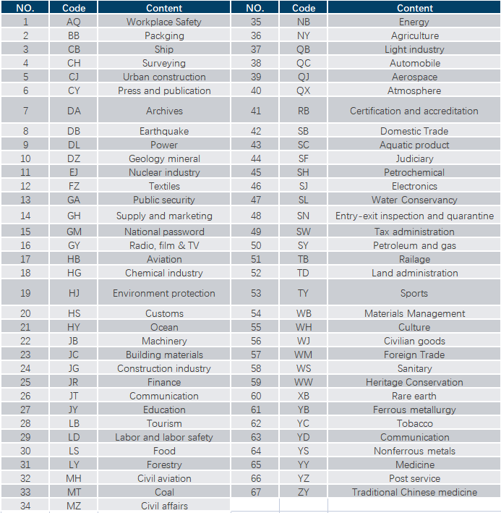

1. Standardization System in China
—Identify
Chinese Standards type
Code of Chinese Standards: 67 Sector Standards Codes
www.sesec.eu

Slide 14
1. Standardization System in China
—Main Players
Governmental Authorities
Non-governmental organizations
National standardization authority：SAC
Administrative authorities in Sectors ：like MIIT, MoT, NMPA, etc.
Local standardization authorities ：
Quality and Technology Supervision Bureaus in provinces, autonomous regions and municipalities directly under the Central Government
Standards development organizations: Institutions under ministries, CESI, CCSA, etc.
National and Sector technical committees
Associations
Enterprises

Slide 15
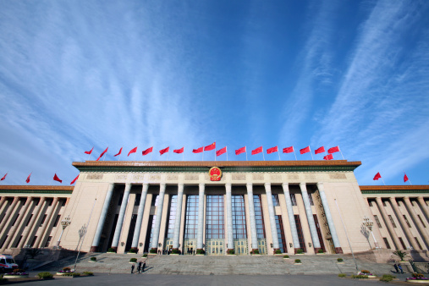
1. Standardization System in China
– Who is doing what
SAC
Manage national standardization work
Project approval, numbering, WTO/TBT notification of mandatory national standards
Develop voluntary national standards
Filing sector standards and local standards
Develop rules for numbering standards
Government-led standardization
TCs/SCs/WGs
Develop standards
Sector administrative authorities
Manage national standardization work
Project approval, numbering, WTO/TBT notification of mandatory national standards
Develop voluntary national standards
Filing sector standards and local standards
Develop rules for numbering standards

Slide 16
1. Standardization System in China
– Who is doing what
Ministry of Civil Affairs:
  SAC and administrative authorities
  in relevant sectors:
an association eligible for developing association standards shall register themself in the authorities for civil affairs
regulate, guide and supervise the development of association standards and enterprise standards
Market-driven standardization
Associations:
Enterprises:
develop enterprise standards
make self-declaration in the Enterprise Standards Information Platform
disclose products’ function and performance indicators
register themselves in the authority for civil affairs
develop association standards
Make public the information of association standards in the Association Standards Information Platform

Slide 17
1. Standardization System in China
– Current Data – as of October 2022
545
All together, these technical
organisations have
51,885 members, of which
3,133 are from foreign enterprises,
accounting for 6% of the total.
national professional
standardisation
technical committees
768
13
branches
(subcommittees)
working groups
Organisations of standardization work
In addition, the Chinese government has also established 277 standardisation research institutions, covering various industries.

Slide 18

1. Figures of China Standards until Feb 2023
Standards in China | Data by end of 2019 | Data in Sept 2020 | Data in Sept 2022 | Data in Feb 2023
National - mandatory | 2,111 | 2,112 (other 78 will be effective soon) | 2,107 (other 75 will take effect soon) | 2109 (other 102 will take effect soon)
National - voluntary | 36,877 | 35,864 (other 978 will be effective soon) | 39,687 (862 will take effect soon) | 39847 (897 will take effect soon)
Sectoral standards | 62,262 | 89,137 | 97,495 (filed) | 78757 (filed)
Local standards | 37,818 | 46,560 | 78,416 | 63,054
Association standards | 9,790 | 18,224 | 43,336 | 52,896
Enterprise standards | 1140000 | No data available | 2,458,513 | 2,643,098
International standards adopted (IDT/MOD of ISO IEC) | 10,000 | Not updated yet | 12,484 | 12,642
[SPEAKER] | [DATE]

Slide 19
1. Figures of China Standards until Feb 2023
[SPEAKER] | [DATE]

Slide 20
1. Figures of China Standards until Feb 2023
[SPEAKER] | [DATE]

Slide 21
2. Standards must be followed
Your products may be covered simultaneously by national, sector, local, or association standards.
2018
REPORT
The standards must be followed if they are:
Voluntary standards that are adopted to support regulations applicable to your products; or
Voluntary standards that are adopted by compulsory certification schemes (not necessary to be CCC) applicable to your products.
Mandatory national standards; or
  Apart from the mandatory national standards, the latter two standards are made de facto “mandatory”; failure to follow them means not be able to enter the Chinese market.

Slide 22
3. International Standards in China
Many international standards have been converted into Chinese standards, some of which are identical to their international prototypes.
By the end of 2023
China has adopted around 10,000 ISO/IEC standards and converted them into Chinese standards (including IDT and MOD).
The adoption rate of international standards in key areas (like IEC) reached 70%.
Note：China only recognizes standards published by ISO, IEC, and ITU as international standards.
Notes:
China is a signatory to the World Trade Organization (WTO) Technical Barriers to Trade Agreement, which stipulates that countries use international standards as the base for their standards.

Slide 23
4. Get involved in relevant standardization work
– Participation in standards development
Direct participation
Take part directly in
the SDOs that draft standards, usually, state-run TCs.
Submitting written
comments
Many draft standards will be posted online for public comment.
Main
Channels
Leveraging industry
associations
Some domestic associations are in charge of the TCs that draft national and sector
standards or even draft these standards directly, and some issue their own standards.
Exerting indirect
influence
Companies can conduct informal advocacy and education efforts with
associations, Chinese partners, and standards-setting bodies.
Please note: Only entities who have registered in China can participate in standards setting!

Slide 24




4. Get involved in relevant standardization work
– Apply for membership
Apply for membership of relevant TCs/SCs/WGs
Most of them are open to foreign companies
Chinese is their work language
Membership fee

Slide 25
4. Get involved in relevant standardization work
– Participation in standards development (Some tips)
Figure out which Technical Committees are important for your products and your companies business strategies
Get contacts with TC secretariates and set up good connections
Emphasize what you can bring to the TC and standardization work
Learn Chinese culture and try to follow the rules (visible or invisible)
Make comments and objections smartly
Make technical lobby strategies (like cooperate with local competitors or the secretariates)
Please note: Only entities who have registered in China can participate in standards setting!

Slide 26
Useful links
SESEC: www.sesec.eu
EU-China Standards Platform: https://webgate.ec.europa.eu/cesip/
National Public Service Platform for Standards Information (Chinese language): http://std.samr.gov.cn/
Sector Standards Information Platform (Chinese language)
MIIT: https://www.miitstd.cn/index.aspx
Ministry of Transport: http://jtst.mot.gov.cn/arch/prof
Ministry of Housing and Rural-Urban Development: http://123.57.49.105:81/bztx/
National Medial Products Administration: http://app1.nmpa.gov.cn/data_nmpa/face3/base.jsp?tableId=21&tableName=TABLE21&title=%D2%BD%C1%C6%C6%F7%D0%B5%B1%EA%D7%BC%C4%BF%C2%BC&bcId=152904437880111023387499337007

Slide 27

Thank you！
Dr. Betty Xu
Seconded European Standardization Expert in China (SESEC)
Room 1005,The Oriental Place, #9 East Dongfang Road, North-Part of Beijing East Third Ring, Chaoyang, Beijing, 100106, P R China
Phone: +86 10 85275366-802
Mobile: +86 185 118 20197
E-mail: betty.xu@sesec.eu
Wesite: www.sesec.eu

